Slide 1
Capstone Project
Facial Emotion Recognition
Rupali Sawant

Slide 2
Introduction
The Indian education landscape has been undergoing rapid changes for the past 10 years owing to the advancement for web-based learning services, specially, eLearning platform.
In a physical classroom during a lecture teacher can see the faces and assess the emotion of the class and tune their lecture accordingly, whether he is going fast or slow. He can identify student who need special attention. Digital classroom are conducted via video telephony software program where its not possible for medium scale class(25-50) to see all students and access the mood. Because of this drawback, student are not focusing on content due to lack of surveillance.
While digital platform have limitations in terms of physical surveillance but it comes with the power of data and machines which can work for you. It provides data in the form of video, audio, and text which can be analysed using deep algorithms.

Slide 3
Problem Statement
We will solve the before-mentioned challenged by applying deep learning algorithms to live video data. The solution to this problem is by recognizing facial emotions.

Slide 4
What Is Facial Emotion Recognition ?
Facial emotion recognition is he process of detecting human emotions from facial expressions. The human brain recognize emotions automatically, and software has now been developed that can recognize emotions as well. This technology is becoming more accurate all the time, and will eventually be able to read emotions as well as our brains do.
Al can detect emotions by learning what each facial expression means and applying that knowledge to the new information presented to it. Emotional artificial intelligence or emotion AL, is a technology that is capable of reading , imitating, interpreting and responding to human facial expressions and emotions.

Slide 5
Applications of Facial Emotion Recognition
Market Research : Companies have traditionally done market research by conducting survey to find out about what consumer want and need. This method however, assume that the preference state are correct and reflect future actions. But this is not always the case. Another popular approach in market research is to employ behaviour methods where users reactions are observe, while interacting with a brand or a product. Although effective, such techniques can quickly become very labor intensive as the sample size increase. In such circumstances, facial expression recognition technology can save the day by allowing companies to conduct market research and measure moment-by-moment facial expressions of emotions automatically, making it easy to aggregate the result.

Slide 6
Video Game Testing : Facial expression recognition can also be used in the video game testing phase. In this phase, usually a focus group of users is asked to play a game for a given amount of time and their behaviour and emotions are monitored, By using the facial expression recognition, game developers can gain insights and draw conclusions about the emotions experience during game play and incorporate that feedback in the making of the final product. Facial expression analysis is a practical means of going beyond the typical survey approach. It is a way of appreciating what the format, it becomes genuinely non-intrusive when it comes to user experience.

Slide 7
About our Dataset
The FER-2013 dataset consist of 28,000 labelled images in the training set, 3,500 labelled images in the development set and 3,500 images in the test set. Each image in FER-2013 is labelled as one of seven emotions: happy, sad, disgust, surprise and neutral with happy being the most prevalent emotion, providing a baseline for random guessing of 24.4%.
The images in FER-2013 consist of both posed and unposed headshots, which are the grayscale and 48x48 pixels.
The FER-2013 dataset was created by gathering the result of a google image search of each emotions and synonyms of the emotions.

Slide 8
Problem in FER-2013
Imbalanced Dataset
Interclass Variation
Contrast
Eye-Glasses
Outlier/Null Values

Slide 9
Dependencies
Python
Tensorflow
Keras
Streamlit
Streamlit-Webrtc
OpenCV

Slide 10
Using a Pre-trained Model
In past, there have been many research in field of computer vision and so topic of emotion recognition was very popular. Some researchers published their own model with various facial feature detection techniques which can be used. Since our aim is built a proper live class monitoring system it is necessary to check how the model works.
We will use DeepFace. DeepFace is a deep learning facial recognition system created by a research group at Facebook. It identifies human faces in digital images. The program employs a nine-Layer neural network with over 120 millions connection weights and was trained on our four million images uploaded by Facebook users.

Slide 11
Validation
- In the validation phase, various OpenCV functions and Keras function have been used.
- Initially the video frame is store in a video object.
- The image frame is converted into grayscale and resized and reshaped with the help of numpy.
- The maximum argument is output.
- A rectangle is drawn around the facial regions and the output is formatted above the rectangular box.

Slide 12
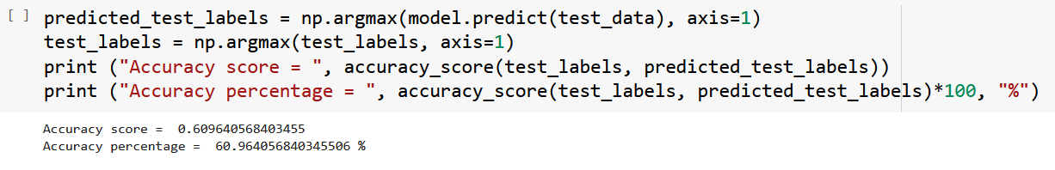
Performance Evaluation
The model gives 62-61% accuracy on validation set while training the model. The CNN model learns the representation features of emotions from the training images . Below are few epochs of training process with batch size of 64.

Slide 13
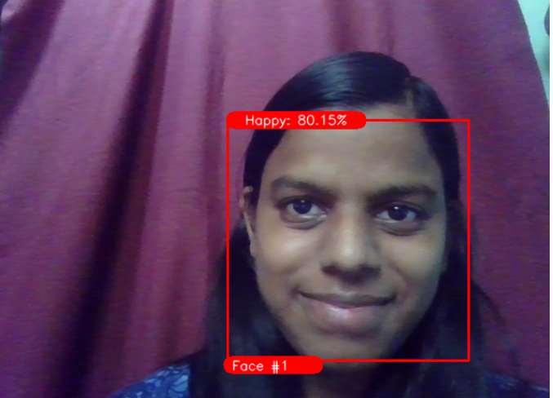
Output

Slide 14
Challenges Faced
While making CNN model, its training was hard in colab as system was crashing often.
Running high epoch was stressful.
Access of webcam in google colab as well as in streamlit was tough.
While deployment , version compatibility has to be properly managed.

Slide 15
Calculation
Our model gave validation accuracy of 60% and train accuracy of 90%.
Model is successfully able detect emotions and faces.
It got easily deployed on Heroku and Streamlit share.
Frontent work has been done using streamlit.

Slide 16
Thank You

